Slide 1
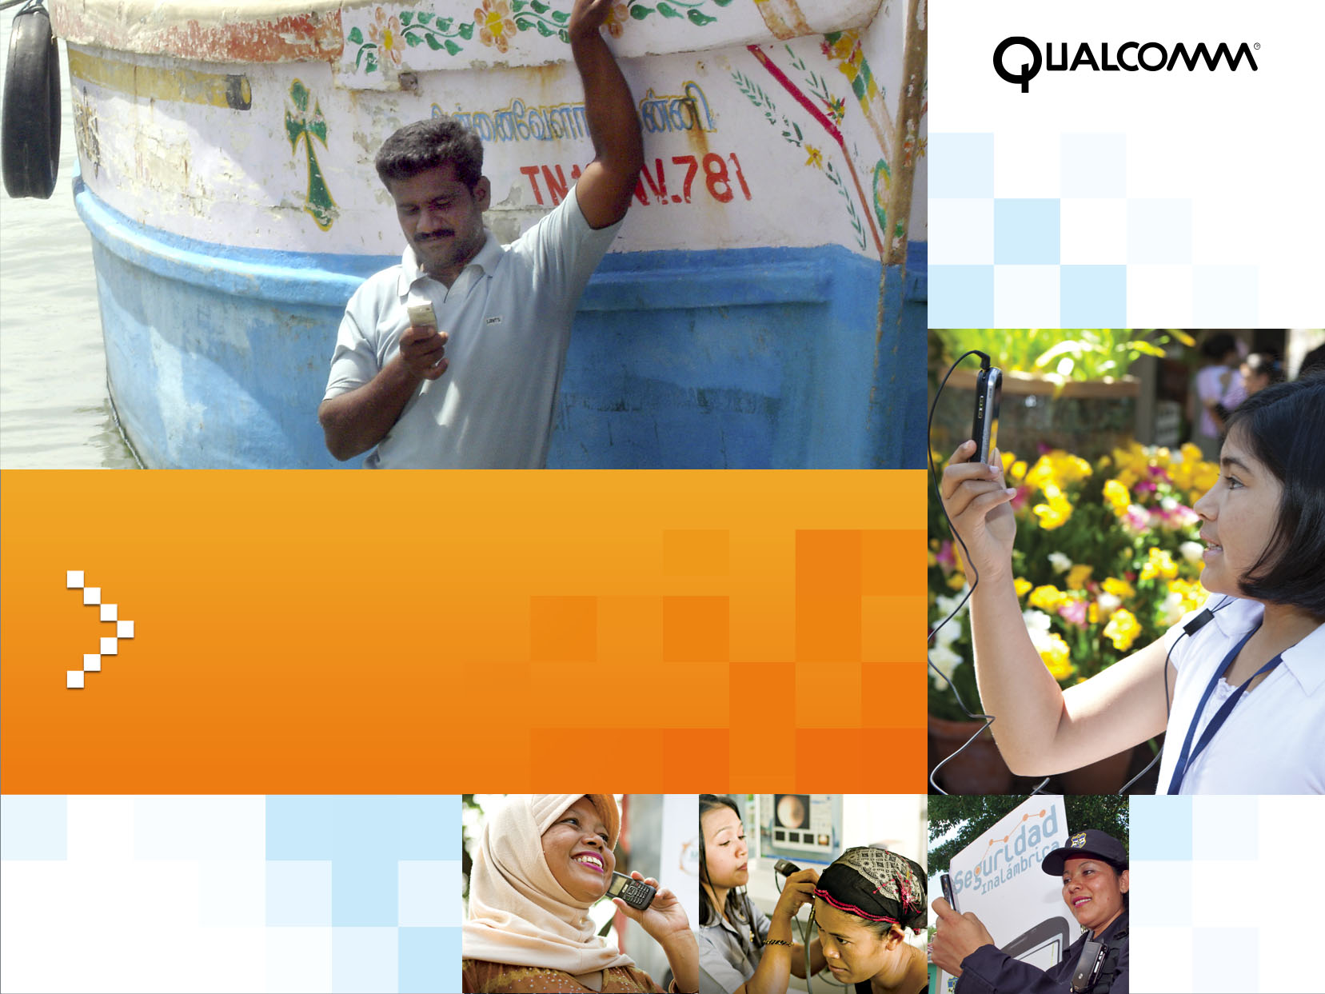
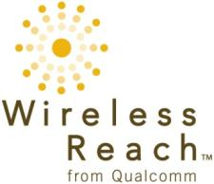
WIRELESS REACH™
Empowering Communities Worldwide
Ashish Aggarwal, India & South Asia

Slide 2

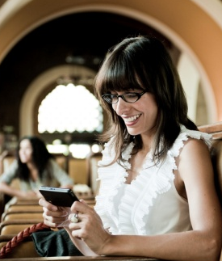
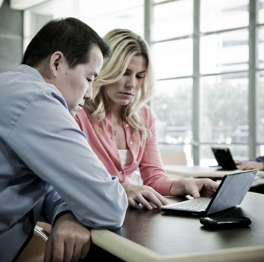

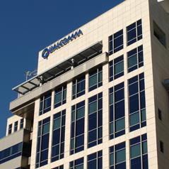
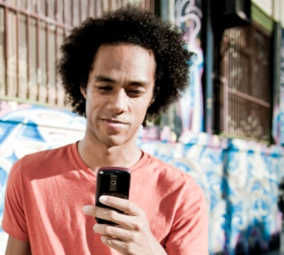

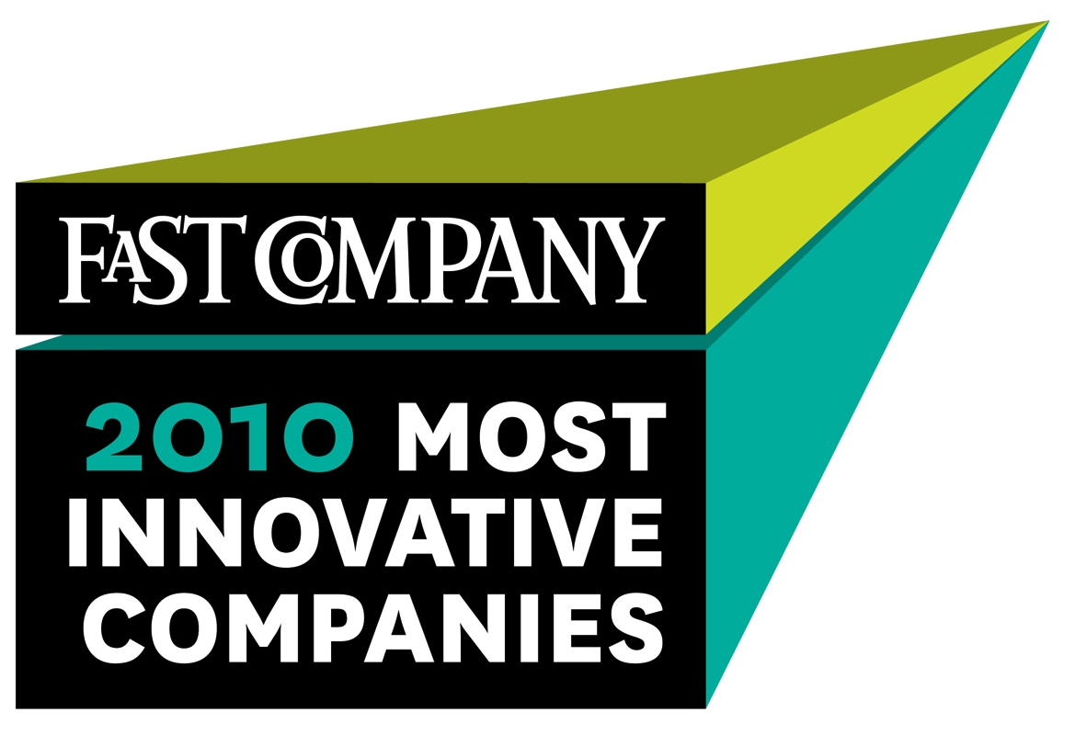



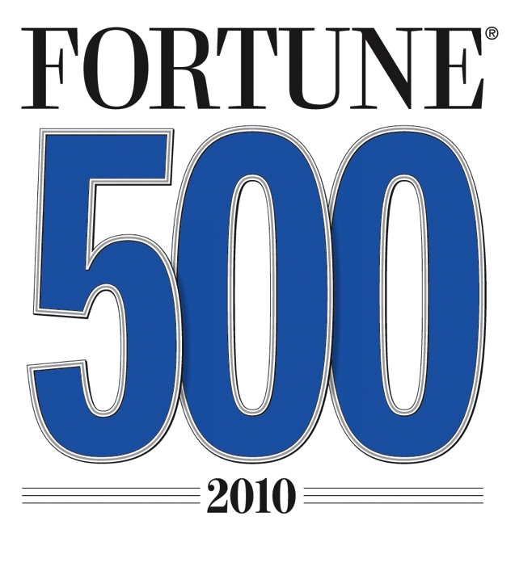
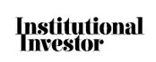

The world leader
in next-generation
mobile technologies
Celebrating 25 years of driving the evolution of wireless communications
Making wireless more personal, affordable & accessible to people everywhere
World’s largest fabless semiconductor
company, #1 in wireless
S&P 100 / S&P 500 / Fortune 500
2011 All-America
Executive Team
Notes:
Qualcomm is the world leader in next-generation mobile technologies.
For 25 years, Qualcomm ideas and inventions have driven the evolution of wireless communications, connecting people more closely to information, entertainment and one another.
Today, Qualcomm technologies are powering the convergence of mobile communications and consumer electronics, making wireless devices and services more personal, affordable and accessible to people everywhere.
Quick facts
More than 17,500 employees around the world (Sept. 2010)
Presence: 139 worldwide locations with 65 in the US (Headquartered in San Diego, CA). (Sept. 2010)
Annual revenue: $10.99 Billion (FY 2010)
Qualcomm chipsets power majority of commercial 3G devices
Our chipsets are in a vast majority of Android-powered smartphones and Windows phones.
23% of our revenues goes right back into R&D (FY2010)
For more information, visit Qualcomm around the Web:
Company website: www.qualcomm.com
Corporate Blog: www.qualcomm.com/blog
Twitter: www.twitter.com/qualcomm
Facebook: www.facebook.com/Qualcomm

Slide 3


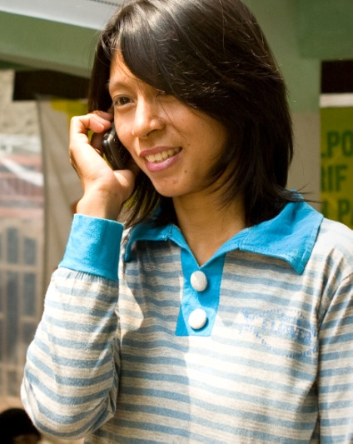
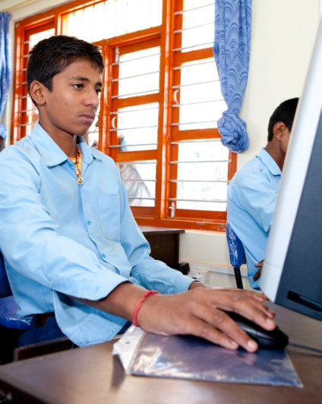
Current State of the World:
A Digital Divide Exists
For Every 100 People Worldwide, 77 Have a Mobile Phone
29%
77%
Global Mobile Penetration
Global Internet Penetration
Source:
² Internet World Stats at www.internetworldstats.com/stats.htm.
As of 3/14/2011.
Source:
¹ Informa WCIS+. Annual total penetration by region.
As of 3/14/2011
Notes:
Despite the rapid pace of technology, a digital divide still exists. As these charts show, 23 percent of the world’s population does not have a mobile phone¹ and 71 percent of the population does not use the Internet. ²
According to statistics from the market database Wireless Intelligence, it took about 20 years for the first billion mobile phones to sell worldwide. The second billion sold in four years, and the third billion sold in two. Eighty percent of the world’s population now lives within range of a cellular network (and those networks are increasingly 3G), which is double the level in 2000. And figures from the International Telecommunication Union showed that by the end of 2008, two-thirds of the world’s mobile phone use was in developing countries. ³
There are now over 5 billion mobile phone users⁴ and many young people have grown up never giving a thought to fixed line telephony; yet still there is this gap between those with access and those without. Women are a significant part of the population without mobile phone access. In fact, a woman in the developing world is 21% less likely to own a mobile phone than her male counterpart. ⁵
Sources:
¹ Informa WCIS+. Annual total penetration by region. As of 3/14/2011. http://www.wcisplus.com/wcisplus/NumericalDataPage.html
² Internet World Stats at www.internetworldstats.com/stats.htm. As of 3/14/2011.
³ MacInnis, Laura. “Mobile Phone Growth Helps Poorer States: U.N.” Reuters. 2 Mar 2009. http://www.reuters.com/article/technologyNews/idUSTRE5211GJ20090302
⁴ Wireless Intelligence estimates as of January 21, 2011 for quarter ending December 31, 2010
⁵ GSMA, Cherie Blair Foundation for Women, and Vital Wave Consulting. “Women and Mobile: A Global Opportunity.” http://www.gsmworld.com/documents/women_mobile.pdf

Slide 4
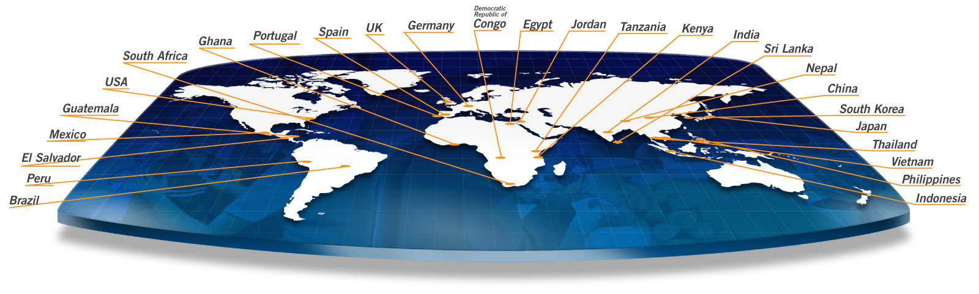
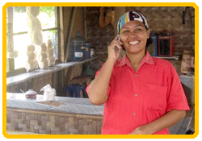

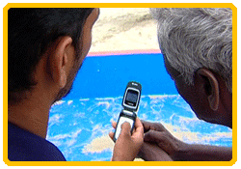
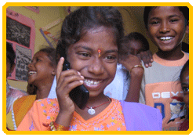
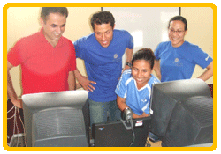
Wireless Reach: A Global Initiative
64 projects in various stages of development in 27 countries
Strengthens social and economic development
6
Notes:
Wireless Reach was formalized in 2006 to demonstrate how 3G can improve people’s lives.
Qualcomm believes access to 3G and next-generation mobile technologies can improve people’s lives. Qualcomm’s Wireless Reach™ initiative is a strategic program that brings wireless technology to underserved communities globally. By working with partners, Wireless Reach invests in projects that foster entrepreneurship, aid in public safety, enhance the delivery of health care, enrich teaching and learning and improve environmental sustainability. For more information please visit www.qualcomm.com/wirelessreach.
To date we have 64 Wireless Reach projects in various stages of development in 27 countries.
This slide shows where we have had or have projects.

Slide 5
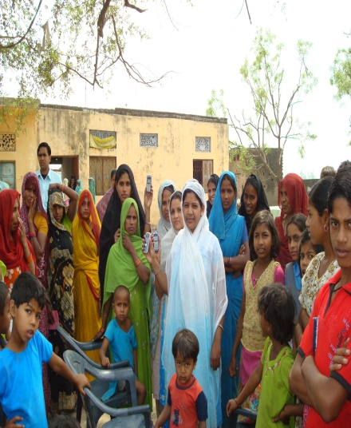
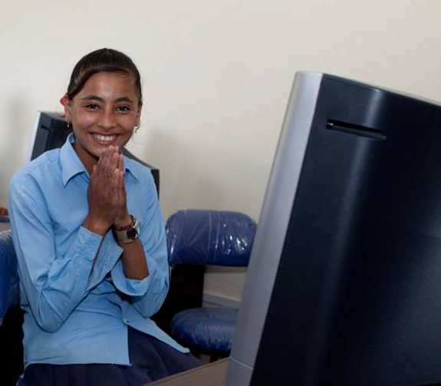
Current status in India
The Digital divide gets underlined
2%
29%
66%
India Mobile Penetration
India Internet Penetration
Source:
Telecom Regulatory Authority of India
Source:
Telecom Regulatory Authority of India
Notes:
Despite the rapid pace of technology, a digital divide still exists. As these charts show, 23 percent of the world’s population does not have a mobile phone¹ and 71 percent of the population does not use the Internet. ²
According to statistics from the market database Wireless Intelligence, it took about 20 years for the first billion mobile phones to sell worldwide. The second billion sold in four years, and the third billion sold in two. Eighty percent of the world’s population now lives within range of a cellular network (and those networks are increasingly 3G), which is double the level in 2000. And figures from the International Telecommunication Union showed that by the end of 2008, two-thirds of the world’s mobile phone use was in developing countries. ³
There are now over 5 billion mobile phone users⁴ and many young people have grown up never giving a thought to fixed line telephony; yet still there is this gap between those with access and those without. Women are a significant part of the population without mobile phone access. In fact, a woman in the developing world is 21% less likely to own a mobile phone than her male counterpart. ⁵
Sources:
¹ Informa WCIS+. Annual total penetration by region. As of 3/14/2011. http://www.wcisplus.com/wcisplus/NumericalDataPage.html
² Internet World Stats at www.internetworldstats.com/stats.htm. As of 3/14/2011.
³ MacInnis, Laura. “Mobile Phone Growth Helps Poorer States: U.N.” Reuters. 2 Mar 2009. http://www.reuters.com/article/technologyNews/idUSTRE5211GJ20090302
⁴ Wireless Intelligence estimates as of January 21, 2011 for quarter ending December 31, 2010
⁵ GSMA, Cherie Blair Foundation for Women, and Vital Wave Consulting. “Women and Mobile: A Global Opportunity.” http://www.gsmworld.com/documents/women_mobile.pdf

Slide 6
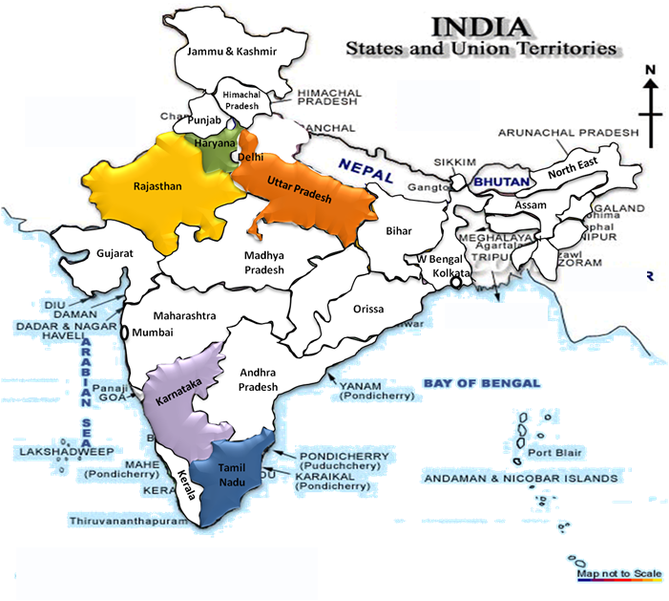
Wireless Reach - India
11 Projects in 5 States of India
Ongoing projects on:
Sectors | States
Livelihood | Tamil Nadu, Rajasthan
Entrepreneurship | Rajasthan, UP
Safety | Tamil Nadu
Environment | UP
Education | Karnataka, Haryana, Rajasthan
Public Health (Proposed) | TBD

Slide 7
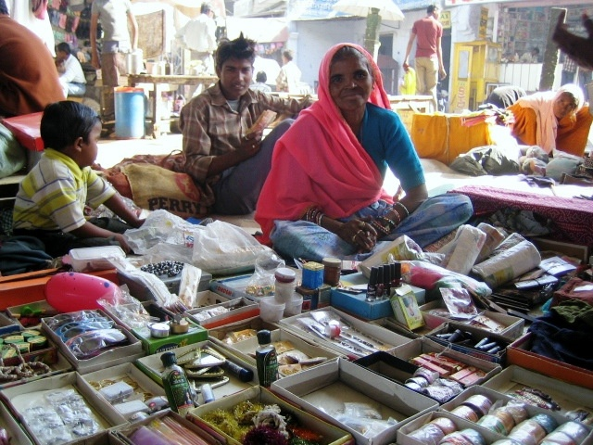
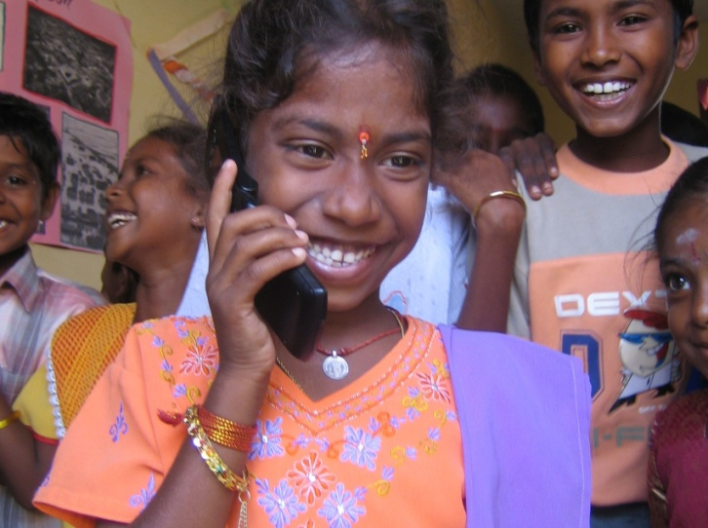
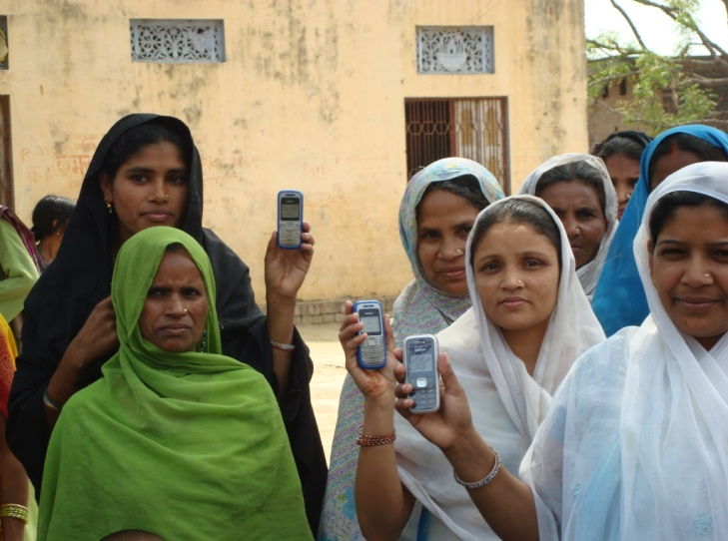
Connecting India to Disconnect
Poverty
ENTREPRENEURSHIP
Partner
Execute
Innovate
Project Concern International, ZMQ Software Systems,
Sonata Finance Pvt. Ltd. ,
Planned Social Concern
Brew®–based software
on CDMA cell phones
Provides women with microfinance loans, the ability to improve credit, increase income and access to information and services
Notes:
7
In economics, the base of the pyramid is the largest, but poorest socio-economic group – the 2.5 billion people globally who live on less than US $2.50 per day.
Connecting India to Disconnect Poverty (CIDP) is designed to assess strategies that empower women entrepreneurs at the base of the pyramid using Brew®-based software applications on CDMA cell phones.
India is the fastest growing telecommunications industry in the world, with a projected 1.159 billion mobile subscribers by 2013 according to Informa Telecoms & Media.
Mobile technology is the largest technology platform in history, and coupled with microfinance, presents an exciting opportunity to reach a large portion of people at the base of the pyramid.
By providing women with a microfinance loan and the ability to improve credit, build income and access to information and services, this program is helping lift entrepreneurs out of poverty.
CIDP is in strong demand among women entrepreneurs, proving its success.

Slide 8
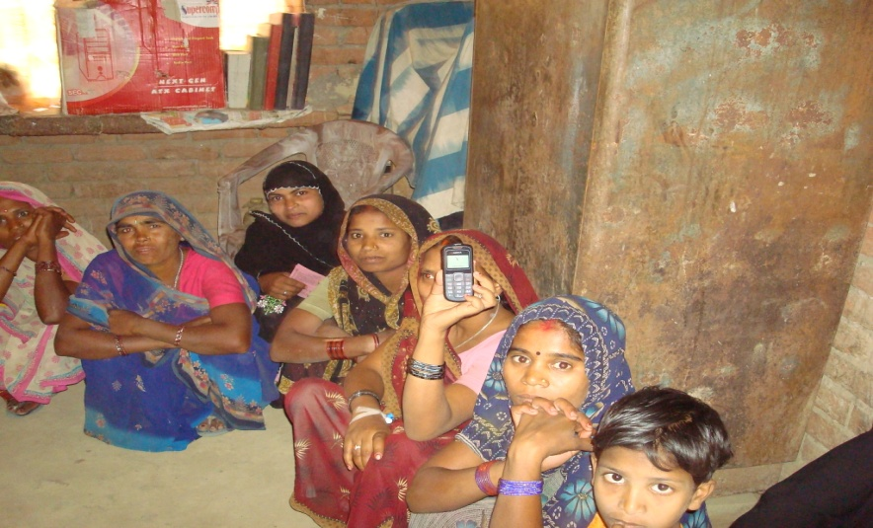
Connecting India to Disconnect
Poverty
Objectives
Develop strategies to empower poor women
entrepreneurs
Offer MFI women clients the ability to access, via
their mobile phones, market information including
MFI transactional data, with the goal of improving
their business
Empower & Enable
Utilizes CDMA technology as an enabler
Icon based menu in the local language.
Sustainability by maximizing access and
minimizing costs
Scope & Impact
In Rajasthan – impact over 700 people
In Uttar Pradesh – impact over 1000 people

Slide 9
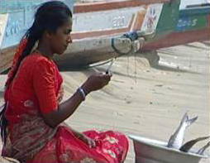
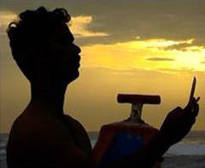
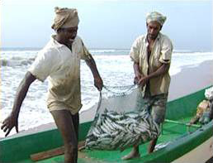
Fisher Friend, Bringing Helpful
Information to Rural Fishermen
PUBLIC SAFETY
Partner
Execute
Innovate
MSSRF, Tata Teleservices,
Astute Systems Technology
Brew® application, 3G mobile phones
Fishermen access information
in their local language
Notes:
In 2007, fishers in the tsunami-affected Tamil Nadu region of India were provided mobile phones with a Brew® application called Fisher Friend that gave them instant access to helpful information in their local language, such as weather conditions, where they can and cannot fish and market prices.
Today the application is commercially available on Tata’s CDMA network for approximately US $.60/month.
Local fishers reported that the application makes them more efficient, feel safer in the water and improves their daily revenue.
In the next phase, to be launched this year, fishers will benefit from the standalone GPS application, which is designed to ensure greater safety and quicker search and rescue in the event of a crisis.
Devanathan, a local fisherman in Puducherry, praised Fisher Friend, claiming there are days when his catch has gone from averaging Rs 200-300 a day (approximately US $3 to $6) to Rs 500-800 a day (approximately US $10 to $16).

Slide 10
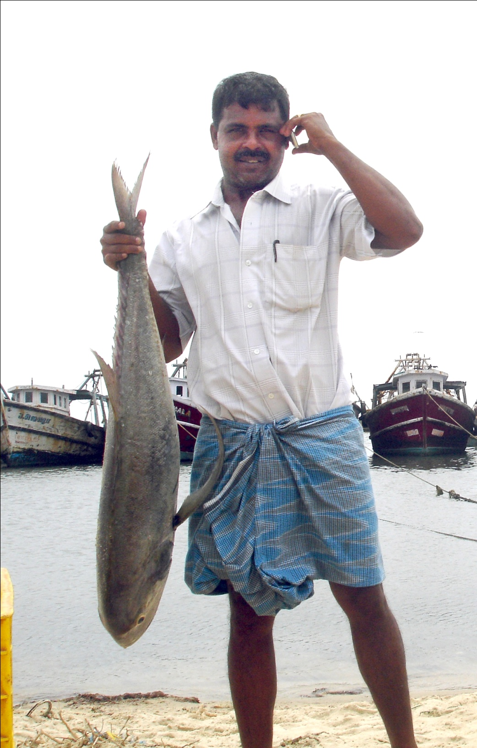

Fisher Friend Mobile Application
Scope - Five Tsunami affected districts of Tamil Nadu State
Predictive content - wave and weather prediction for the successive 4 days
FEATURES
Wave height forecast information & Potential Fishing zone
News flash & Government schemes
Icon based interface
Market information
Yellow pages & Clip of the day
SGPS ( To be Launched )

Slide 11
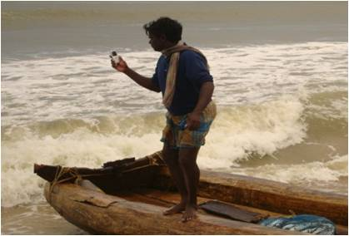
Fisher Friend Mobile Application
Over 20 villages and 500 users already reached and impacted by the project
IMPACT
81 lives recorded saved from disaster till date due to FFMA weather
and wave height updates and alerts
Over 100 fishermen recorded to have benefited economically through
Fishing zones and Market rates information
Over 13 fishermen have benefitted from the Government Schemes information
Increase in efficiency by 30% routinely reported with over 300 fishermen
outside the pilot project downloaded the application

Slide 12
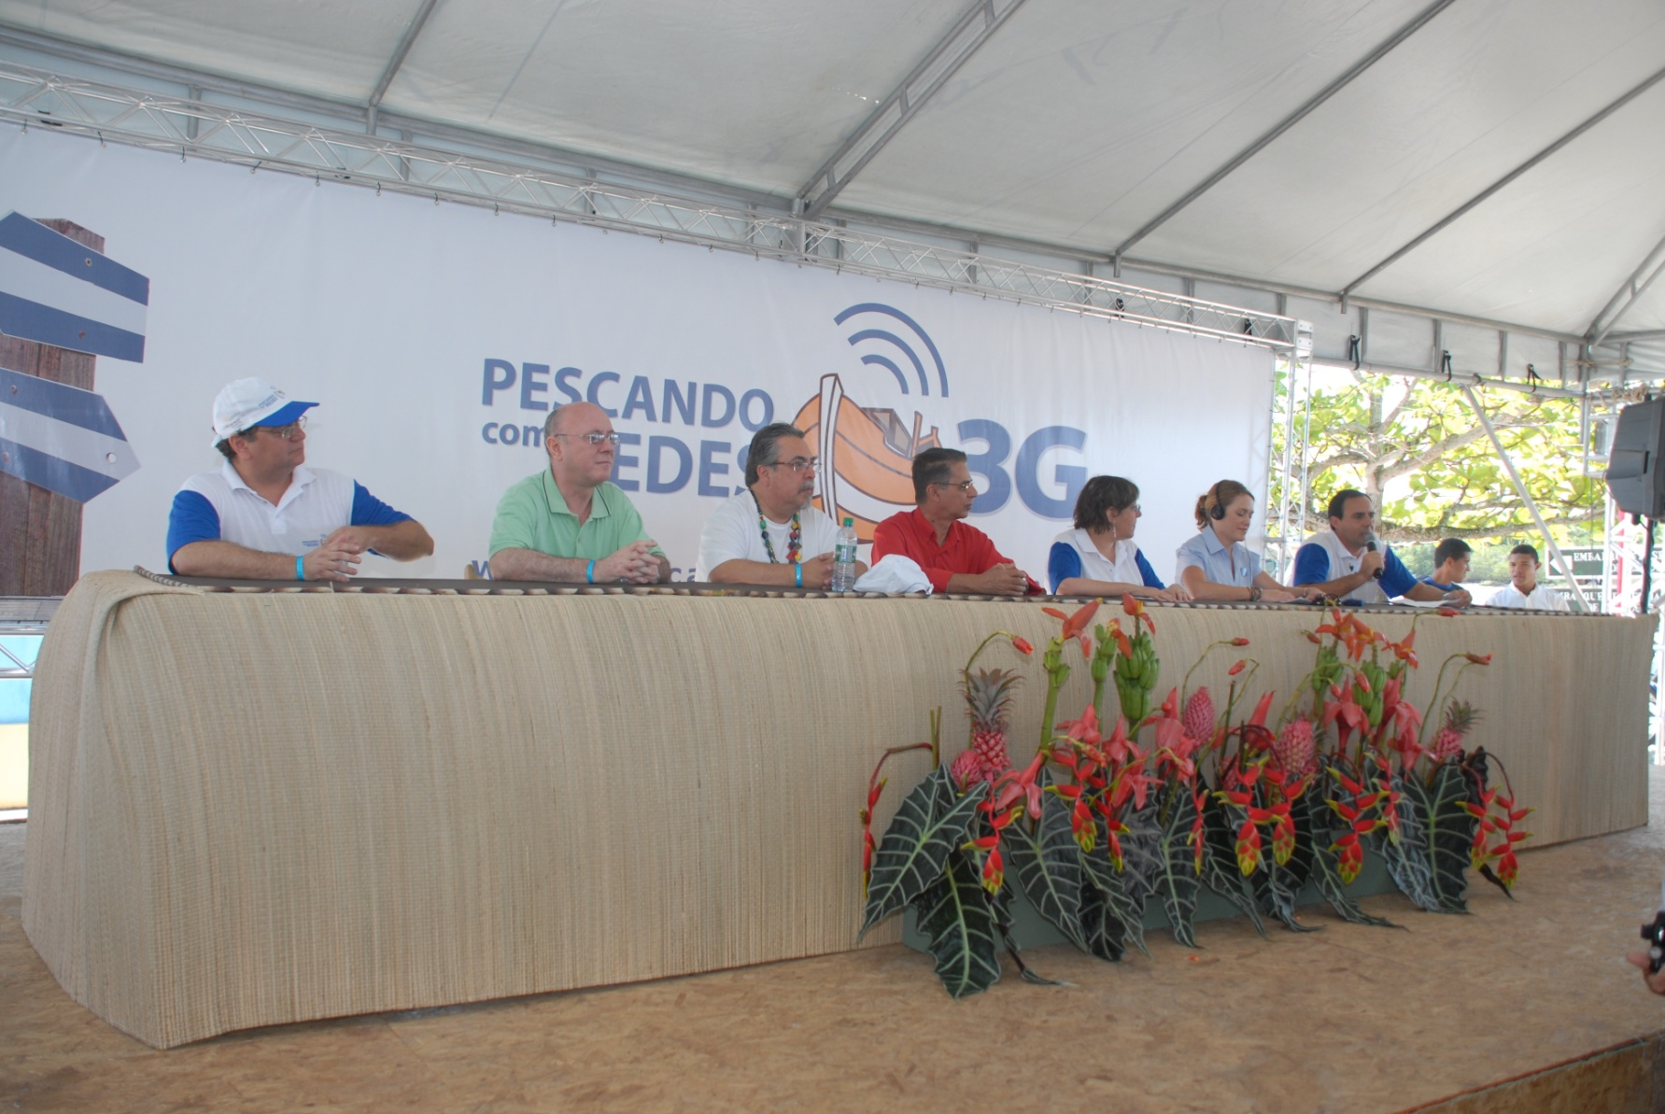
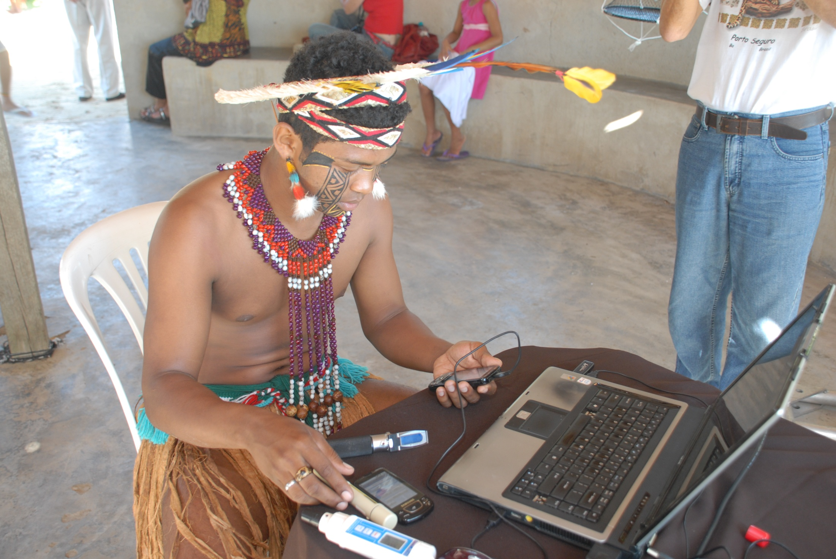
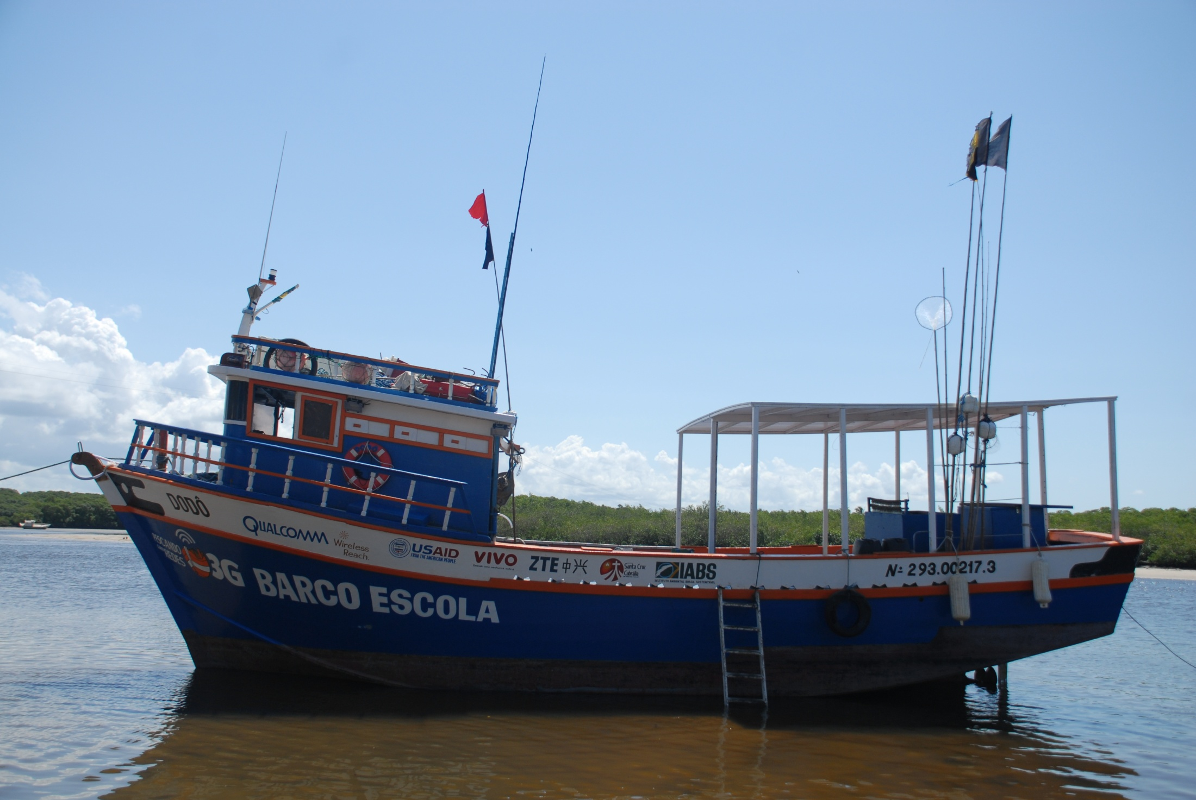
Brazil: Fishing with 3G Nets
ENTREPRENEURSHIP
ENTREPRENEURSHIP & ENVIRONMENT
Partner
Execute
Innovate
Vivo, USAID, Environmental Sustainability Institute of Brazil, ZTE, Municipality of Santa Cruz Cabrália
3G handsets, HSPA network, customized mobile device applications
Fosters sustainable fishing practices and increases public safety and economic opportunities
Notes:
12
Many families depend on fishing for their livelihood in Bahia, Brazil, but recently the industry has suffered from over-fishing, lack of investment and old infrastructure.
As a result, people’s incomes and opportunities have decreased, which has led to the emigration of family members in search of jobs.
Fishing with 3G Nets enables the fishers to modernize their operations and institutionalize sustainable fishing tactics.
As part of the project, participants are given mobile devices with mobile credit to access Vivo’s 3G HSUPA wireless network; allowing them to connect from offshore to land with consumers and business partners.
By establishing direct links between fishers and local inns and restaurants, 3G technology increases local income by eliminating the need for middlemen and expensive storage of fish.
With 3G connectivity, participants can wirelessly monitor water conditions such as pH levels, salinity and temperature. Access to this new data allows the successful cultivation of oysters and enhances opportunities for the community by diversifying the traditional fishing activities of the region.
The mobile applications help with inventory monitoring, tracking of income and expenses, and fishing statistics, empowering them and improving their ability to make a profit.
Using the computer lab donated by the project, participants attend free courses in environmental education and economic alternatives and learn valuable IT skills.
Furthermore, hands-on courses offered in the "floating school boat" create new and more sustainable possibilities by teaching techniques for catching various fish species.

Slide 13
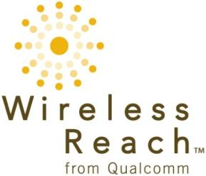
Thank you!
ashiagga@qualcomm.com
www.qualcomm.com/wirelessreach

Slide 14
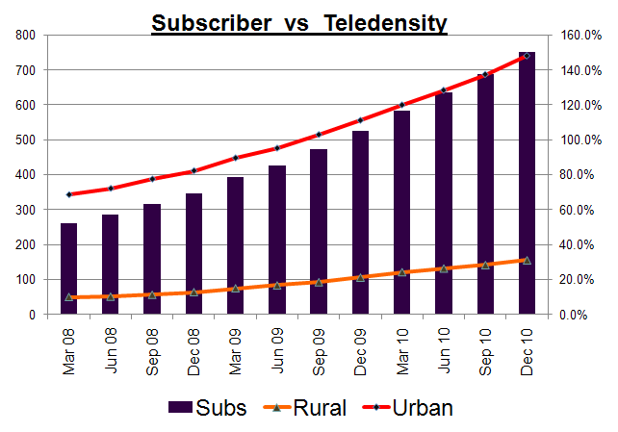
Mobile Wireless Tele density - India
Source : TRAI Performance Indicator Quarterly Reports

Slide 15
Global Wireless Penetration Rate

