Slide 1
Is India Important to
US Economic Growth?
Noel Massie
President
UPS / Central California
June 23, 2011

Slide 2
UPS Global Presence We enable global commerce by serving 220 countries and territories around the world
Founded in Seattle, Wash August 28, 1907
Headquarters Atlanta, Ga.
Chairman and CEO Scott Davis
Employees 400,600 (330,600 U.S.; 70,000 International)
2010 revenue $49.6 billion (SP and SCS)
Service area More than 220 countries and territories; Every address in North America and Europe
UPS Browntail aircraft 218 in service (224 aircraft total)
Daily flight segments 942 US domestic; 815 International
Facilities (Supply Chain and Freight) 776 facilities in more than 120 countries; 31 million sq. ft.
Customers 8.5 million daily (1.1 million pick-up, 7.4 million delivery)
Online tracking Average 26.2 million daily tracking requests
Key services Logistics and distribution; transportation and freight (air, sea, ground, rail); freight forwarding; international trade management and customs brokerage
Specialty services Service parts logistics; technical repair and configuration; supply chain design and planning; returns management

Slide 3
Worldwide Reach, Global Possibilities UPS Moves 2% of World GDP (Est. $1.3Trn)
UNITED STATES
UPS Worldport® provides the most diverse range of services available from any single operation.
EUROPE
Our European Headquarters in Brussels oversees all operations throughout Europe and the Middle East. The Cologne facility offers the only integrated pan-European ground/air package network.
ASIA
Our Shenzen Hub offers more time-of-day options to and from destinations around the world.
LATIN AMERICA
UPS is the largest express and air cargo carrier in Latin America.
AFRICA
UPS has full service coverage to all major markets in Africa to support these emerging trade lanes.
Notes:
‘No other transportation business can match the connected network resources of UPS on every continent’
UPS is the only logistics and transportation company with a dense global network on all continents.
United States
Our capability in this market is without equal. One network operation delivers over 2.3m packages and freight items per day. One access point, one solution.
Latin America
In South America our scale domination continues where we operate the largest package and freight network available.
Europe
The UPS ‘transborder’ service portfolio is exceptionally diverse, but the key here is the integrated approach we provide. Our service portfolio is harmonized so whether you are in the UK, Spain, Germany or Poland you and your customers experience exactly the same service options through a single connection.
Asia
Recently we opened our Shenzhen Hub as the centre piece to UPS operational capability in Asia. Through this facility and our extensive footprint of facilities throughout the area, UPS offers more time of day delivery options than any other carrier

Slide 4
UPS Asia Pacific Established in 1986, UPS Asia Pacific has rapidly expanded to cover more than 40 countries and territories, serving the most exciting and dynamic region
Asia Headquarters Singapore
President Derek Woodward
Employees 13,600 in Asia
Service area 40+ countries and territories
Points of Access 2,700+ (UPS Express, Mailbox Etc., Customer Service Centres, authorized shipping outlets and alliances)
Operating Facilities 302 (admin offices, package centres, hubs, gateway offices, distribution centres and warehouses)
Asia Pacific Delivery Fleet 2,111 (package vans, trucks, trailers and vans and motorcycles)
Asia Pacific Aircraft Fleet 29 (operating within Asia)
Weekly Browntail Flights Intra-Asia 238; International 160
Asia Pacific Hubs Shanghai, Shenzhen, Hong Kong

Slide 5
UPS India Presence
Chandigarh
India headquarters:
Mumbai
Employees: More than 700
Operations began 1988
Operational Profile:
Nationwide delivery coverage
Five international airports served:
Mumbai, Chennai, New Delhi, Bangalore and Cochin
Seven weekly flights to/from Mumbai
12 operating facilities:
Ahmedabad, Bangalore, Chennai, Hyderabad, Jaipur, Kolkata, Ludhiana, Moradabad, Mumbai, New Delhi, Pune, and Tirupur
10 brokerage facilities
Nine UPS Supply Chain Solutions® facilities
Delhi
Moradabad
Ludhiana
Jaipur
Amedabad
Kolkata
Bhiwandi
Mumbai
Pune
Aurangabad
Hyderabad
Bangalore
Chennai
Cochin
Tirupur
Airports
UPS Facilities
UPS Supply Chain Solutions Facilities
Notes:
5
INDIA HEADQUARTERS UPS Jetair Express UPS Jetair Express Pvt Ltd, Plot No. 6-A, Shyam Nagar, Off Jogeshwari Vikhroli Link Road, Majas Village, Jogeshwari (E), Mumbai 400 060 India.
UPS Supply Chain Operations UPS SCS India Pvt. Ltd. 901, 9th Floor, Alfa Building, Main Street Hiranandani Business Park, Powai, Mumbai 400 076 India.
MANAGING DIRECTOR, UPS Indian Subcontinent Mark Khambatta
POINTS OF ACCESS Over 219 points of access across India
EMPLOYEES 727 in India; 400,600 Worldwide
DELIVERY FLEET 76 (scooters, trucks and vans)
UPS FLIGHTS 7 weekly flights to and from Mumbai
AIRPORTS SERVED 5 (Mumbai, Chennai, New Delhi, Bangalore and Cochin)
BROKERAGE OPERATIONS 10 (Bangalore, Chennai, Cochin, Hyderabad, Kolkata, Mumbai, New Delhi, Pune, Ahmedabad, Jaipur)
OPERATING FACILITIES 12 (Ahmedabad, Bangalore, Chennai, Hyderabad, Jaipur, Kolkata, Ludhiana, Moradabad, Mumbai, New Delhi, Pune and Tirupur)

Slide 6
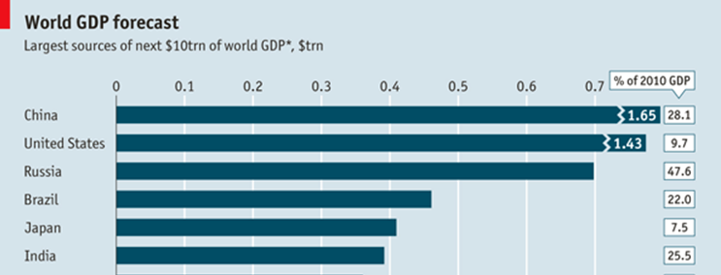
India’s Contribution to the World Economy
WORLD GDP over the past 12 months was about $65 trillion
In the year September 2013, global output will be about $10 trillion higher, according to the IMF’s projections
India is projected to be the 6th largest contributor to world GDP through 2013
Source: The Economist

Slide 7
India / US Trade Statistics
India is the 13th largest trading partner with Los Angeles
Los Angeles is the 2nd largest US Customs district trading with India and represents 11.7% of total trade with the US
Of the top 5 US Customs districts, Los Angeles is the fastest growing at 50.5%
Source: WorldCity analysis of U.S. Census Bureau data

Slide 8
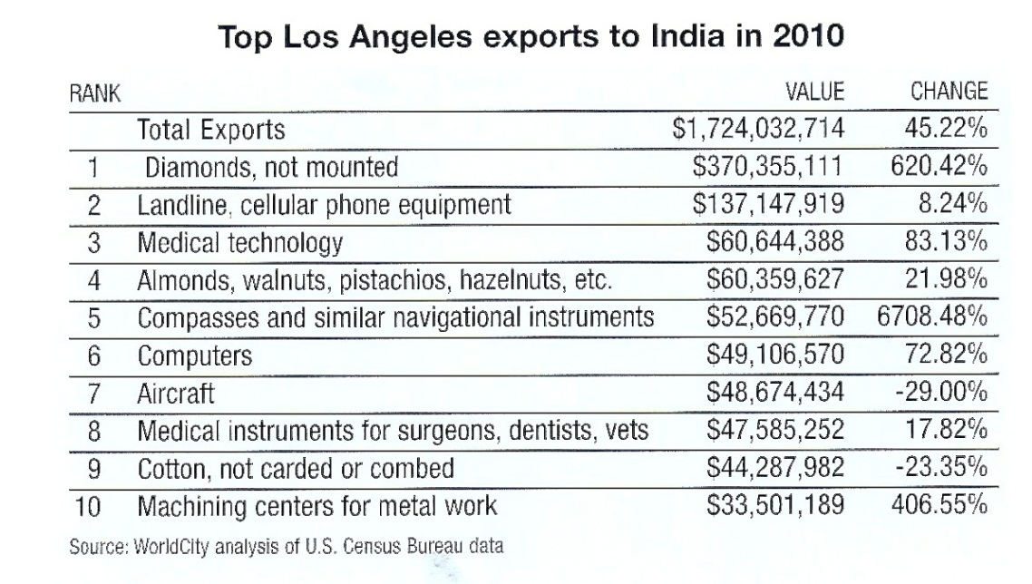
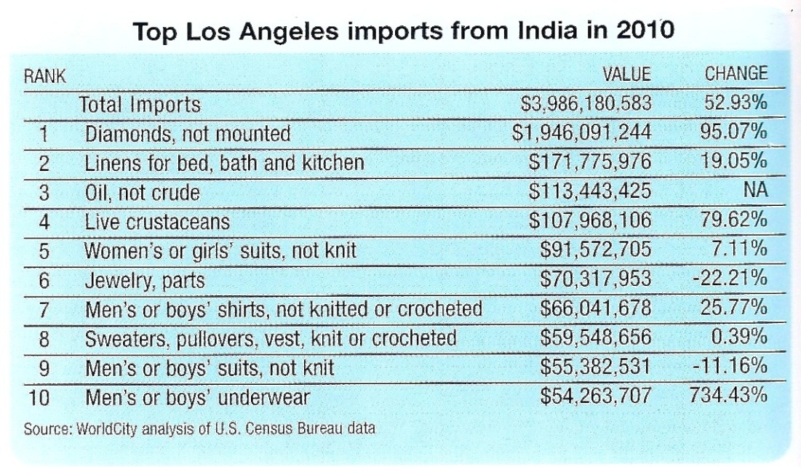
Top Import and Export Goods: India / Los Angeles
Top exports to India include items critical to infrastructure development
Top imports from India are heavily weighted towards the apparel industry
Source: WorldCity analysis of U.S. Census Bureau data

Slide 9
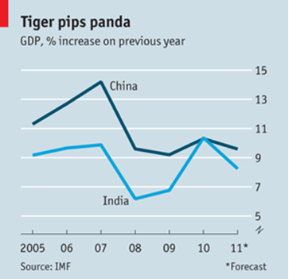
Economic Growth: China vs. India
China grew by 10.3% in 2010
India grew by 10.4% in 2010
Source: The Economist

Slide 10
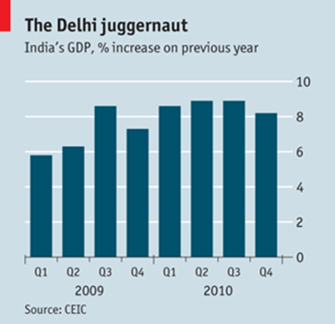
Is India Important for US Growth?
Advantages
10th ranked Economy according to the IMF
2nd fastest growing economy after China
Young Population
Large Growing Middle Class
Increased Demand for Durable Goods
US has the 2nd Largest Population of Indians outside of India (UNDP)
India is the #2 Country of Origin for International Students in US Universities (104,897 students in 2010)
Only China, among big economies, has surpassed India’s 8.6% growth (Q4 2010)
Source: The Economist

Slide 11
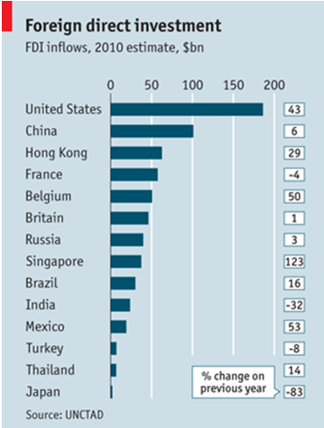
Is India Important for US Growth?
Challenges
Foreign Direct Investment Decreasing
Growing Inflation Rates
Increases in Bad Debt
Allegations of Corruption
Infrastructure and Agricultural Distribution System Challenges
Net flows into India contracted by nearly a third, to $23.7 billion.
Source: The Economist
Notes:
According to the UN Conference on Trade and Development (UNCTAD), global inflows of foreign direct investment (FDI) in 2010 totaled $1.12 trillion, a shade more than the $1.11 trillion recorded during 2009.
More than $100 billion of FDI poured into China, making it the world’s second-largest recipient of such investment.

Slide 12
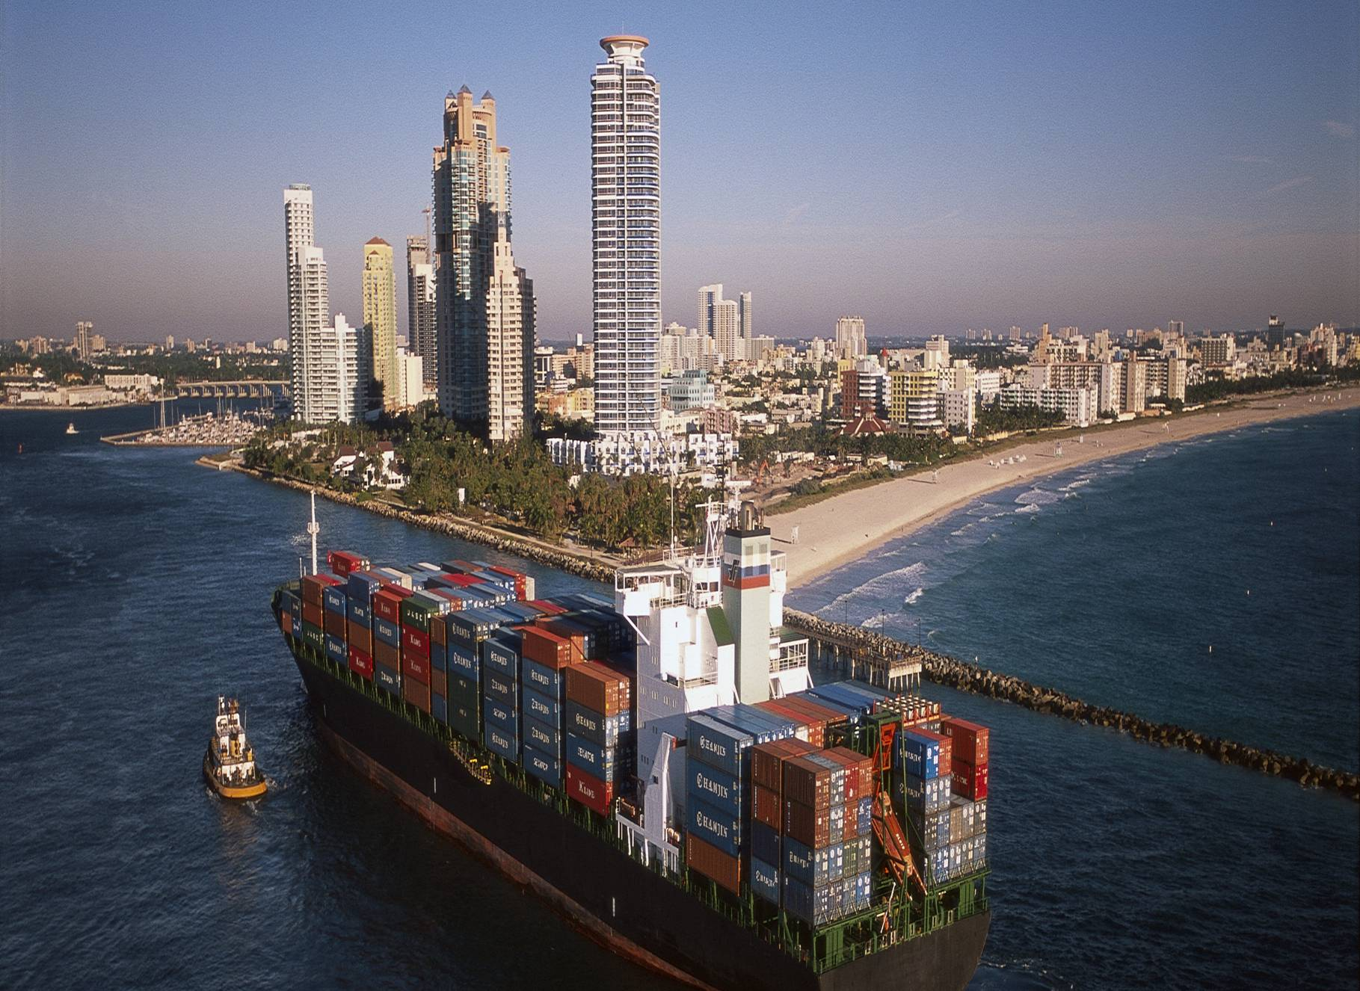
What Must India do to Drive Growth?
Increase Foreign Direct Investment
Slow the Rate of Inflation
Improve Domestic Infrastructure
Policy Reform

Slide 13
Thank You

